Slide 1
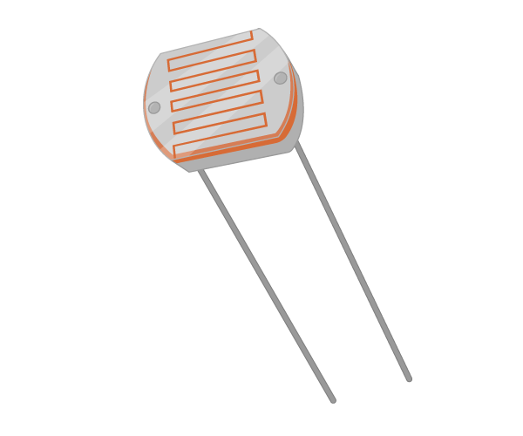
LDR Sensor
LDR Interfacing with Arduino

Slide 2
What is LDR?
LDR stands for Light Dependent Resistor. Additionally, it is known as a photoresistor or photocell.
A LDR is a type of resistor that changes resistance as light on its surface changes. That is, as more light shines on the LDR, its resistance decreases.
Conversely less light or more darkness on the LDR surface causes its resistance to increase.
We generally use these resistors as "Light Sensors", meaning we can sense if the light is dim or bright.

Slide 3
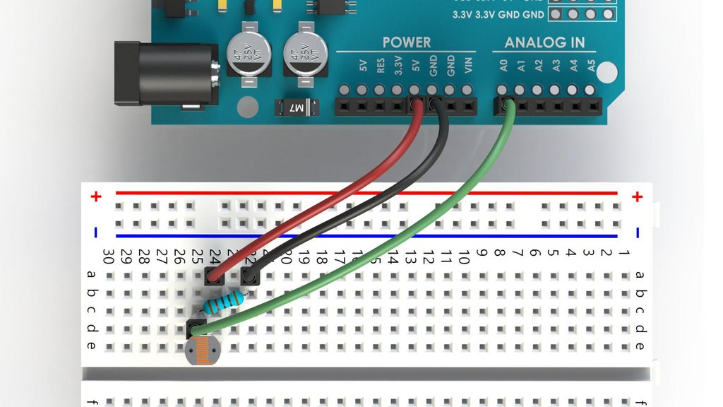
Schematic Diagram

Slide 4
Connect the LDR with the Arduino Uno, follow the step by step, and connect in the same way:
First place the LDR inside a breadboard, orientation is not important, same as normal resistors, LDR don't care about the polarity.
Place the 10 k Ohm resistor on one side of the LDR, this is our Pull Down resistor which we are going to connect with the ground.
Connect the other end of the 10 k Ohm resistor with the GND on the Arduino, and the other side of the LDR with the 5 V pin on the Arduino.
Now we need to insert an analog read jumper wire in parallel with the LDR. We do that by connecting the A0 with the LDR at the point before the 10 k Ohm resistor.

Slide 5
Code
#define LDRpin A0
int LDRValue = 0;
void setup()
{
Serial.begin(9600);
}
void loop()
{
LDRValue = analogRead(LDRpin);
Serial.println(LDRValue);
delay(2);
}

Slide 6
Code Explanation
We first define a variable LDRpin and designate the A0 analog pin for it, also we will create the LDRValue variable where we will store current "light intensity".
We start the serial communication, which we need if we want to see the sensor data on the serial monitor, we choose that the date rate transmitted will be 9600 bits per second, which is basically a default.
We now store the value of the LDR into an LDRValue variable using the analogRead command and we display that value on a Serial Monitor with the Serial.println command.
Now we have to connect the Arduino with the PC using the USB cable, upload the code to the board, and press the Serial Monitor button in the top right corner of the Arduino IDE.

Slide 7
Applications
It is used for automatic contrast and brightness control in television receivers.
It is used in photosensitive relay
It is used in optical coding.
It is used in street light control circuits.
It is used in the security alarm.
It is used in light activated control circuits.
etc

Slide 8
Task
Control an LED via LDR Sensor.
Instructions:
Program should switch on the LED when its dark.

Slide 9
Task Solution
const int ledPin = 13;
const int ldrPin = A0;
void setup() {
Serial.begin(9600);
pinMode(ledPin, OUTPUT);
pinMode(ldrPin, INPUT);
}
void loop() {
int ldrStatus = analogRead(ldrPin);
if (ldrStatus <=300) {
digitalWrite(ledPin, HIGH);
Serial.println("LDR is DARK, LED is ON");
}
else {
digitalWrite(ledPin, LOW);
Serial.println("---------------");
}
}

